Slide 1


Business analysis of freshco hypermarket introducing a home delivery service in the year 2021.
FRESHCO
HYPERMARKET
To ensure seamless operations and optimize customer satisfaction, the store diligently maintained a comprehensive transaction data sheet, containing detailed information at the order level.
~ Jeevan S

Slide 2
Delivery charges as a percentage of product amount at slot and month level.
Across all slots and acquisition months, the grand total sum of product amount is $8,004,849, with total delivery charges amounting to $468,946.
The overall average percentage of delivery charges relative to the product amount is approximately 5.86%.
Slot-specific Trends:
Late Night slots tend to have a higher percentage of delivery charges relative to the product amount compared to other slots, with an average of 12.26%.
Morning slots, on the other hand, have the lowest average percentage of delivery charges at 5.29%.
Month-wise Trends:
Across all slots, there is variation in the average percentage of delivery charges across different acquisition months.
For instance, Late Night slot acquisition month 2 has the highest average percentage of delivery charges at 15.48%, while Morning slot acquisition month 9 has the lowest at 0.67%.
Trends and Patterns:
Across all slots and acquisition months, the grand total sum of product amount is $8,004,849, with total delivery charges amounting to $468,946.
The overall average percentage of delivery charges relative to the product amount is approximately 5.86%.
Slot-specific Trends:
Late Night slots tend to have a higher percentage of delivery charges relative to the product amount compared to other slots, with an average of 12.26%.
Morning slots, on the other hand, have the lowest average percentage of delivery charges at 5.29%.
Month-wise Trends:
Across all slots, there is variation in the average percentage of delivery charges across different acquisition months.
For instance, Late Night slot acquisition month 2 has the highest average percentage of delivery charges at 15.48%, while Morning slot acquisition month 9 has the lowest at 0.67%.

Slide 3
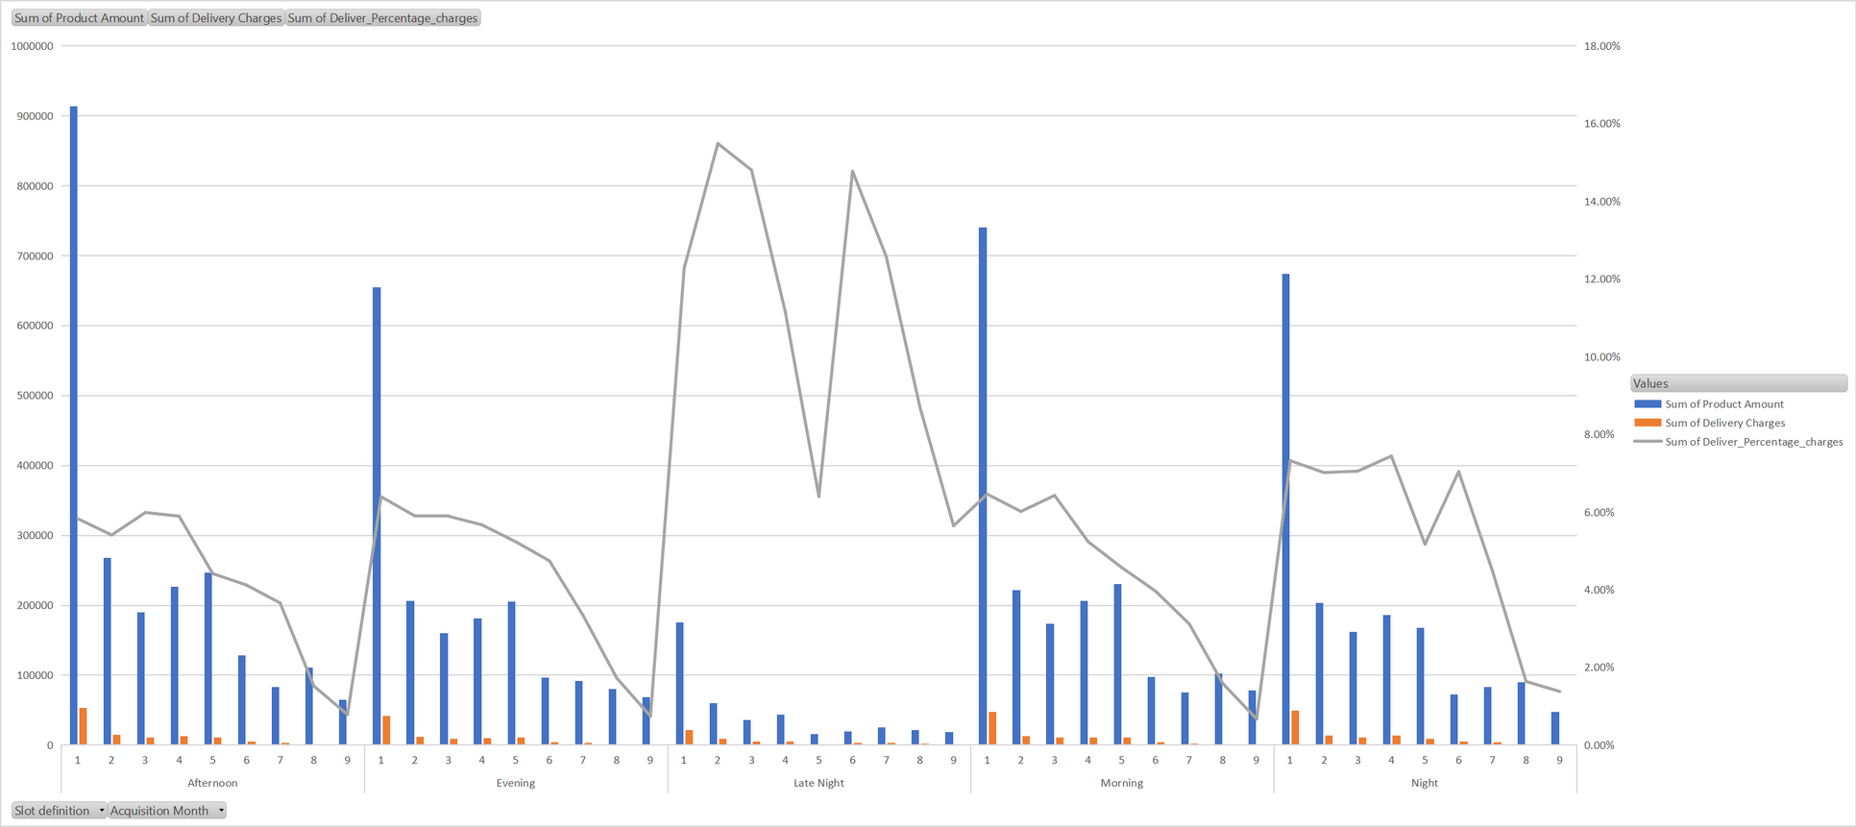
DELIVERY CHARGES AS A PERCENTAGE OF PRODUCT AMOUNT AT SLOT AND MONTH LEVEL.

Slide 4
Discount as a percentage of product amount at slot and month level.
Trends and Patterns:
Across all slots and acquisition months, the grand total sum of product amount is $8,004,849, with a total discount amounting to $510,163.
The overall average percentage of discount relative to the product amount is approximately 6.37%.
Slot-specific Trends:
Late Night slots tend to have lower average discounts as a percentage of product amount compared to other slots, with an average of 3.73%.
Morning slots, on the other hand, have the highest average discount percentage at 6.45%.
Month-wise Trends:
There is variation in the average discount percentage across different acquisition months within each slot.
For instance, Late Night slot acquisition month 5 has the highest average discount percentage at 12.34%, while Afternoon slot acquisition month 8 has the highest at 22.46%.

Slide 5
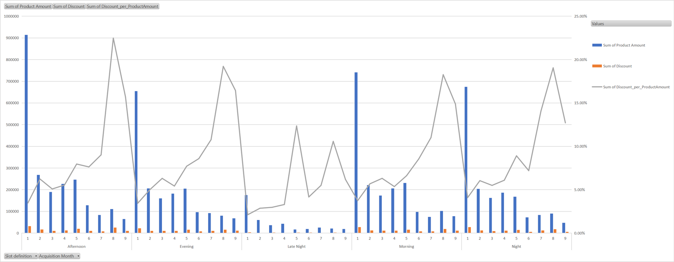
Discount as a percentage of product amount at slot and month level.

Slide 6
Completion rate at slot vs day of the week (Sunday to Saturday) level
Overall Completion Rate:
The grand total for completion flags across all slots and days of the week is 22,721.
This indicates that there were a total of 22,721 completed orders during the observed period.
Day-wise Completion Rate:
We can observe that completion rates vary across different days of the week.
The completion rate is relatively higher on Sundays (3,517) and gradually decreases towards the end of the week, with the lowest completion rate observed on Saturdays (3,373).
This suggests a possible trend where completion rates are higher at the beginning of the week and decrease towards the weekend.
Slot-wise Completion Rate:
Across different slots, the completion rates also vary.
The Morning slot has the highest completion rate (5,363), followed by the Afternoon slot (5,909).
Late Night has the lowest completion rate (1,579) among the observed slots.

Slide 7
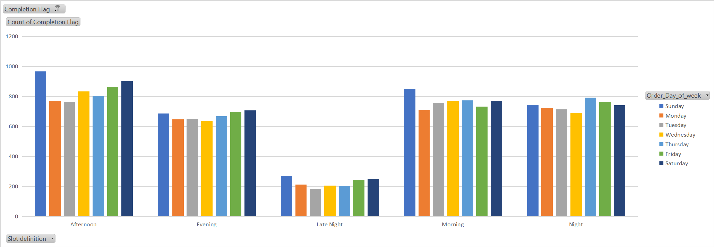

Completion rate at slot vs day of the week (Sunday to Saturday) level

Slide 8
Aggregated LTV at customer acquisition source level
TTop Performing Acquisition Sources:
Google and Organic acquisition sources stand out as the top performers, with sum of customer lifetime values of $2,048,655 and $2,423,055 respectively.
Operational Insights:
Understanding the performance of different customer acquisition sources can help businesses allocate resources effectively and prioritize investment in channels that yield higher returns.
Analyzing customer lifetime value by source enables businesses to identify which marketing channels or campaigns are most successful in acquiring valuable customers.
By focusing on top-performing acquisition sources and optimizing strategies for other channels, businesses can maximize their overall customer lifetime value and improve profitability.
Channels with higher completion rates may indicate better targeting, customer engagement, or conversion optimization strategies.
es:

Slide 9
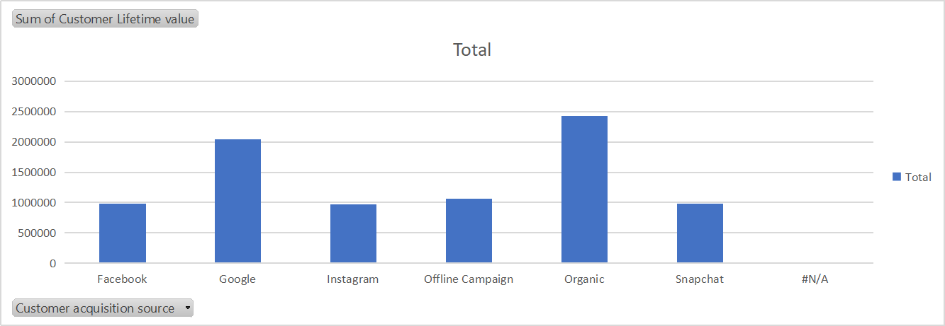
Aggregated LTV at customer acquisition source level

Slide 10
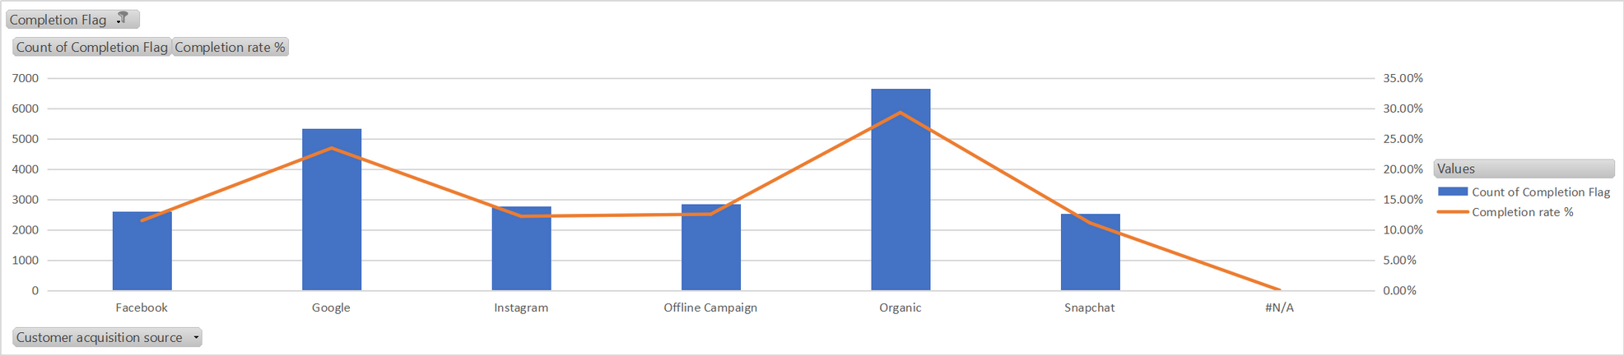
Completion rate at source level

Slide 11
Pattern in delivery charges with delivery slot
Operational Insights:
Late Night orders incur the highest average delivery charges, possibly due to factors such as increased labor costs for nighttime deliveries or higher demand during late hours.
Nighttime deliveries may involve additional logistical challenges or higher transportation costs, contributing to the higher average charges.
Morning and Afternoon slots, having lower average delivery charges, may indicate more efficient delivery operations or lower demand during these times.
Understanding slot-wise differences in delivery charges can help businesses optimize delivery routes, allocate resources effectively, and adjust pricing strategies to maintain profitability while meeting customer expectations.

Slide 12
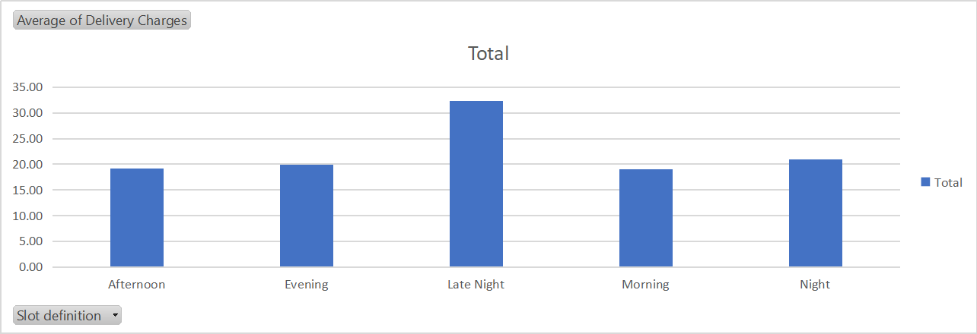
Pattern in delivery charges with delivery slot

Slide 13

THANK
YOU

